Slide 1


K.J.SOMAIYA INSTITUTE OF ENGINEERING AND INFORMATION TECHNOLOGY SION, MUMBAI - 400 022 ENGINEERING PHYSICS-I FOR FULLFILMENT OF PROJECT WORK IN SEMESTER-I TITLE: Li-Fi Technology
SR. NO | ROLL NO. | NAME
1. | FEB-44 | PRAJAPATI MEHUL ASHWIN
2. | FEB-7 | CHAVAN TANUJ VIJAY
3. | FEB-11 | DILSHAD BURHANUDDIN ABBAS
4. | FEB-12 | DUSMAN DIVYANG BHIKAJI
5. | FEB-16 | GHOLAP VIRAJ SANJAY
6. | FEB-47 | PATEL CHIRAG LADHABHAI
7. | FEB-53 | SHAYANK SATVIK

Slide 2


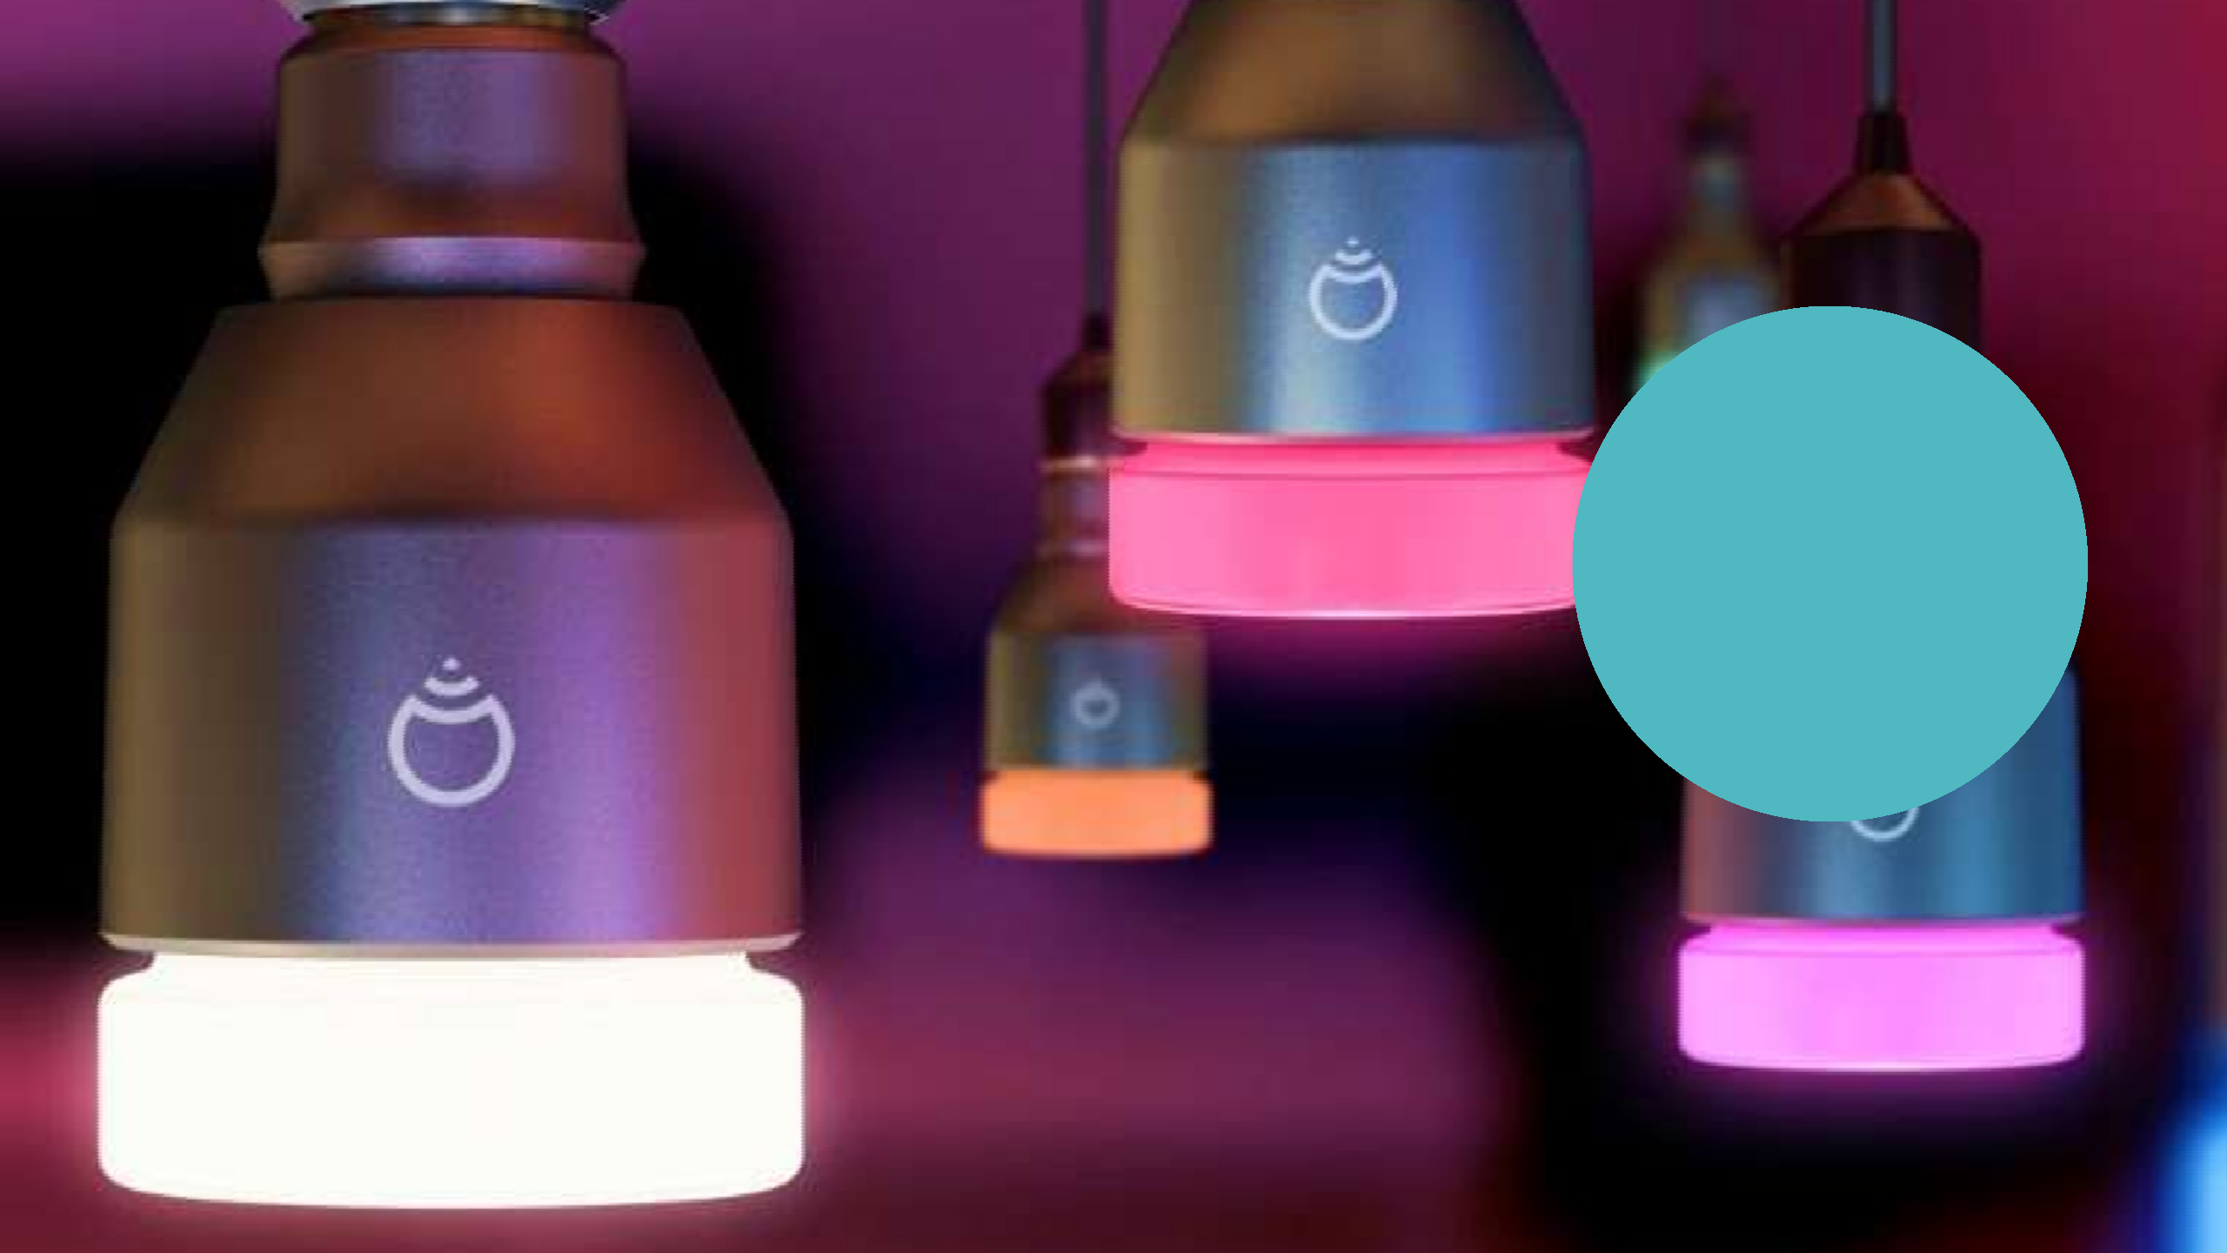



LI-FI TECHNOLOGY

Slide 3
CONTENTS
Introduction to LI-FI
History of LI-FI
Implementation of LI-FI
How it works
LI-FI vs WI-FI
Application
Advantages
Limitation
Future Developments
Conclusions

Slide 4
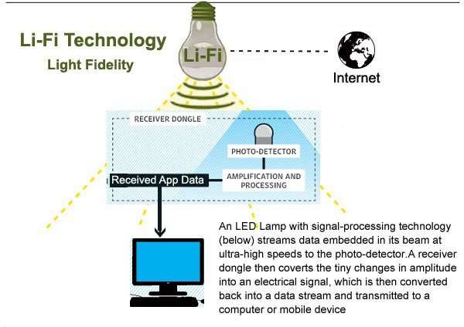

WHAT IS LI-FI….??
?
LIFI –”LIGHT FIDEALITY” is transmission of data through illumination, i.e. sending data through a LED light bulb that varies in intensity faster than human eye can follow.
Li-Fi is a light based Wi-Fi it uses light instead of radio waves to transmit information.

Slide 5
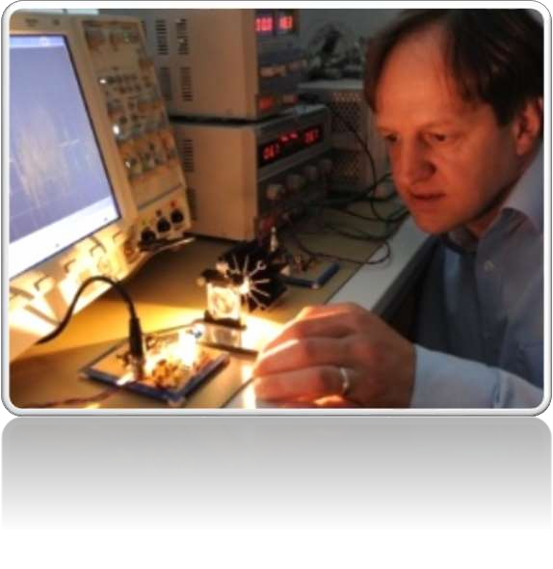
HISTORY -
The technology truly began during the year 1990’s in countries like Germany , Korea and Japan where they discovered LED’s could be retrofitted to send information . Prof. Harald Hass from university of Edinburgh. continues to wow the world with the potential to use light for communication
He demonstrated in year 2012.

Slide 6
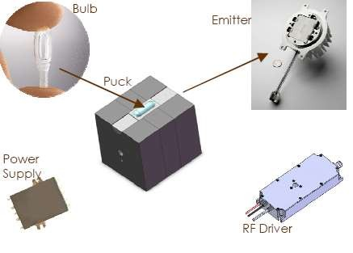
IMPLEMENTATION OF LI-FI
The LI-FI product consists of three primary sub assemblies
Emitter
RF Driver
Power Supply

Slide 7
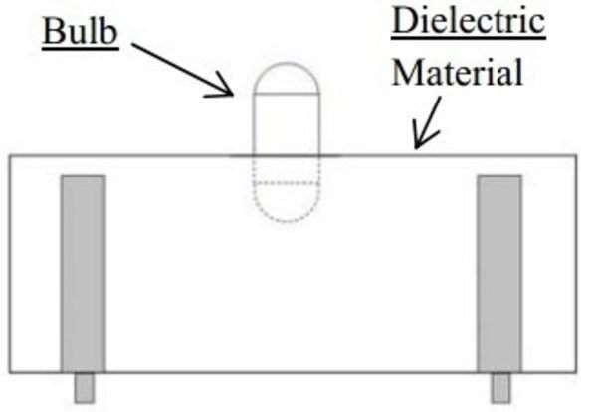
FUNCTION OF BULB ASSEMBLY -
At the heart of LI-FI is the bulb sub assembly where
a sealed bulb is embedded in a dielectric material
The dielectric material serves two purposes
Wave guide
Electric field

Slide 8
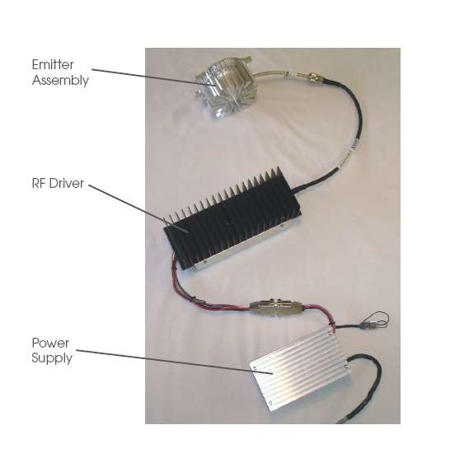
RF DRIVER -
Power amplifier (PA) assembly that uses an LDMOS device.
Converts electrical energy into RF
power.
The PA is designed to ruggedness and efficiency.
The RF driver also contains controls circuit for digital and analog lighting controls.

Slide 9
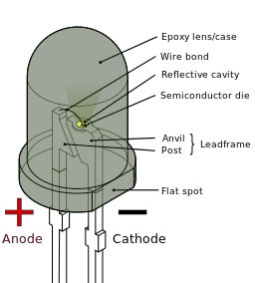
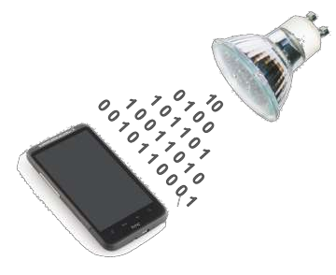
HOW LI-FI WORKS-
Operational procedure is very simple, if the LED is on, you transmit a digit 1, if its off you transmit a digit 0.
the LED’s can be switched on and off quickly, which gives nice opportunities for transmitting data. hence all that us required is some LEDS and a controller that code data into those LEDs.
We have to just vary the rate at which the LEDs flicker depending upon the data we want to encode.
Thus every light source will work as a hub for data
transmission.

Slide 10
LIFI/WIFI COMPARISON
PARAMETER
LI-FI
WIFI
Speed
Range
Data density
Security
Transmit/receive power
Device-to-device connectivity
Reliability
Obstacle Interference
High Low High High High
High Medium Low Medium Medium
High Medium Low
High Medium High

Slide 11
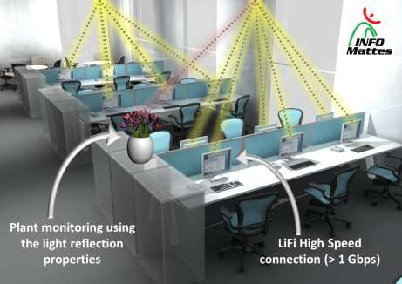
APPLICATIONS -
Top 5 fundamental applications:
Li-Fi and Live Streaming:
According to a Global reports, 82% of consumers prefer to watch live videos than videos that are not live anymore. high-speed rates Li-Fi can reach, can be made available in big shopping malls, sport stadium, street lights, air planes, trains including underground, train stations, airports
Used for modern medical instruments.
In aircrafts, it can be used for data transmission.
Used in petroleum or chemical plants where other transmission or frequencies can be hazardous.
In traffic signals, LI-FI can be used which will communicate with the LED lights of the car and number of accidents can be decreased.
Location based services:-GPS
Underwater communication.
RF Spectrum relief.
Li-Fi can be used effectively in the places where it is difficult to lay the optical fiber cable.

Slide 12
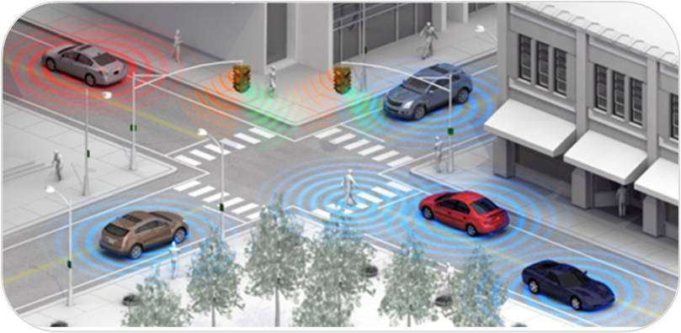
ADVANTAGES -
Larger bandwidth.
High efficiency.
More availability.
High security.
Thousands and millions of street lamps can be conv to Li-Fi spots.
No license needed.
Green information technology.
Lighting points used as Hotspots.
The issues of the shortage of radio frequency bandwidth may be sorted out by Li-Fi.
This technology worldwide can be used for every street
lamp would be a free data access points.
erted

Slide 13
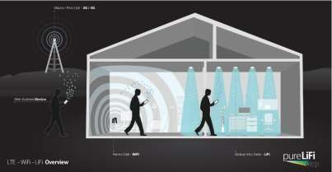
LIMITATIONS -
Li-Fi doesn’t work in the dark .
Li-Fi has a big drawback compared to Wi-Fi, unlike Wi-Fi we cannot move to other rooms unless there are wired bulbs too.
Light can’t pass through the objects.
Interference from external sources like sun light, normal bulbs, and opaque materials in the path of transmission will course interruption in the communication.
High installation cost of the VLC systems.
A major challenge facing Li-Fi is how the receiving device will transmit back to transmitter.

Slide 14
FUTURE DEVELOPMENTS -
Efficient alternative to radio-based wireless.
Li-Fi is an emerging technology which is quick and reliable.
Air waves are clogged so let’s use light waves.
Hence, let’s proceed to Li- Fi for a brighter ,cheaper and greener future.

Slide 15
CONCLUSION -
Overcomes the limitations of radio spectrum.
High speed of 10Gbps can be achieved.
The possibilities are numerous and can be explored further.
If this technology can be put into practical use, every bulb can be used something like
a Wi-Fi hotspot.
we will proceed toward the cleaner, greener, safer and brighter future.
This may solve issues such as the shortage of radio-frequency bandwidth.
Allows internet where traditional radio based wireless isn’t allowed such as aircraft or
hospitals
LI-FI is enabled by advance digital transmission technologies

Slide 16


REFERENCE -
http://en.wikipedia.org/wiki/Li-Fi
seminarprojects.com/s/seminar-report-on-Li-Fi
http://teleinfobd.blogspot.in/2012/01/what-is-lifi.html
technopits.blogspot.comtechnology.cgap.org/2012/01/a- Li-Fi-world
www.lificonsortium.org
the-gadgeteer.com/2011/08/LI-FI

Slide 17


ANY QUESTIONS-

Slide 18
THANK YOU

